Slide 1


Effectiveness of the policy responses to COVID-19
Hugues Nelson Iradukunda
DATA 606 Capstone Project
Prof. Chaojie (Jay) Wang

Slide 2
Motivation & Introduction
Since March 2020, COVID-19 was declared as a global pandemic.
As of today, the COVID-19 infections are a half of billion cases and the death toll is about 6 millions worldwide.
Several restrictions were imposed by countries to minimize the infections and deaths.
The goal of this study is to use machine learning model with a focus to understand effectiveness of the governmental policy responses to COVID-19 worldwide with latest information.

Slide 3
Personal of Interests
Policy and decision-makers around the world regarding the restrictions or lockdown measures.
Citizens can understand how governments are working in terms of fighting against COVID-19 in a consistent way.
Form the government perspective, being able to predict COVID confirmed cases could be used to measures what policy responses are effective.

Slide 4
Research questions or Hypotheses
Have policy responses contributed in preventing COVID-19 over the past 2 years?
Are the collected COVID-19 policy responses statistically significant in predicting the infections?
What are COVID-19 policy responses drivers in predicting the confirmed cases?

Slide 5
Data sources
The timeserie data being explored comes from COVID-19 policy tracker presented by the Oxford Covid-19 Government Response Tracker (OxCGRT). The OxCGRT systematically collects information on several different common policy responses governments have taken, records these policies on a scale to reflect the extent of government action, and aggregates these scores into a suite of policy indices all over 180 countries worldwide.
This data also include the number of reported COVID-19 confirmed cases and deaths in each country around the globe. These are collected by the Center for Systems Science and Engineering (CSSE) at Johns Hopkins University data repository for all countries and the US States.

Slide 6
Data
The different COVID-19 policy responses are coded into 21 indicators, such as public places closures, travel restrictions, testing and vaccinations.
COVID-19 policy responses are into grouped five categories: C: containment and closure policies, E: economic policies, H: health system policies, V: vaccination policies, M: miscellaneous indicator.
There is a strigency index where a higher score indicates a stricter government response (i.e. 100 = strictest response) based on policy indices. However, the stringency index cannot say whether a government's policy has been implemented effectively.

Slide 7
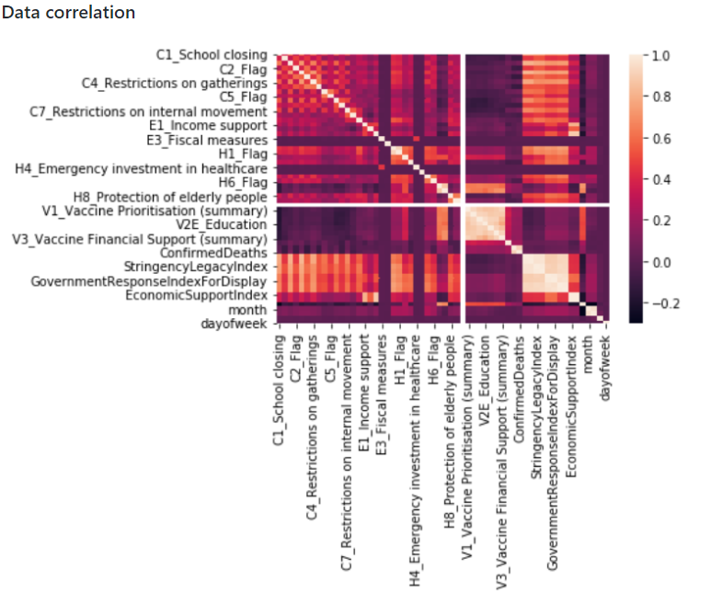
Exploratory Data Analysis (EDA): Heatmap

Slide 8
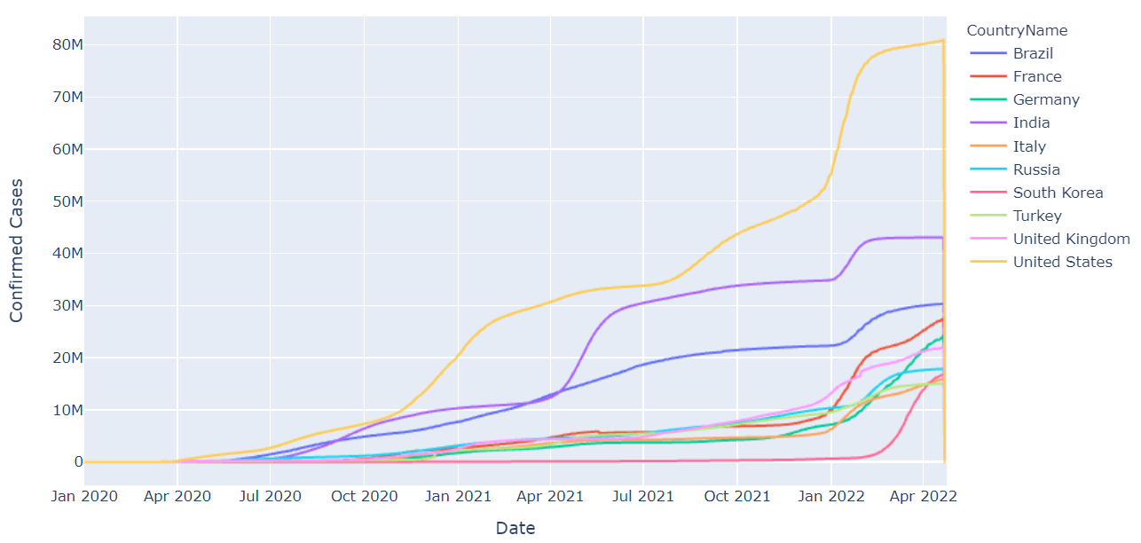
Trends of top 10 countries by COVID-19 Cases
The chart indicates the trends of the top countries with high infection rates. US has the highest number of cases, followed by India, then Brazil and so on.

Slide 9
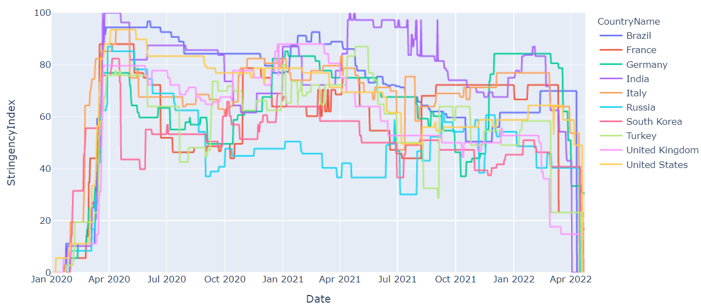
Trends of top 10 countries with high confirmed cases and their given stringency index
A higher position in stringency index does not necessarily mean that a country's response is better in fighting with COVID than others lower on the stringency index.
Some of policy responses contributed in minimizing the number of coronavirus disease infection rates, especially in the early phase of the pandemic.

Slide 10
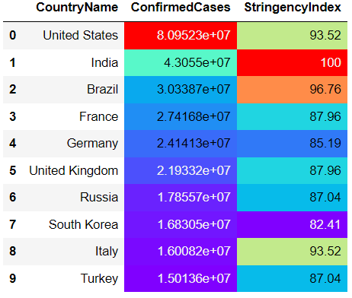
Table of top 10 countries by COVID-19 Cases and their highest Stringency Index so far.

Slide 11
Machine Learning Model: Target vs. Predictors variables
The target variable is ConfirmedCases.
Other remaining attributes, except string objects type representing countries names and codes are considered as inputs variables for our machine learning regression models.

Slide 12
Ordinary Least-Squares (OLS) Model
According to the OLS Model results:
Overall, OLS Model 𝑅-ssquared is 0.843, so our model is capturing 84% of the variance in ConfirmedCases.
The attributes used in this dataset are statistically significant except H1_Flag, H7_Flag, V1_Vaccine Prioritisation (summary), V2G_Frontline workers (healthcare), V2B_Vaccine age eligibility/availability age floor (general population summary)_55-59 yrs, V2B_Vaccine age eligibility/availability age floor (general population summary)_80+ yrs, V2C_Vaccine age eligibility/availability age floor (at risk summary)_16-19 yrs, V2C_Vaccine age eligibility/availability age floor (at risk summary)_55-59 yrs, and V2C_Vaccine age eligibility/availability age floor (at risk summary)_75-79 yrs since they have a greater than the usual significance level 0.05.

Slide 13
OLS Model Results
The main strongest drivers of the ConfirmedCases predictions are:
ConfirmedDeaths,
H2_Testing policy,
V4_Mandatory Vaccination (summary),
H8_Protection of elderly people
due to their high t-statistics.

Slide 14
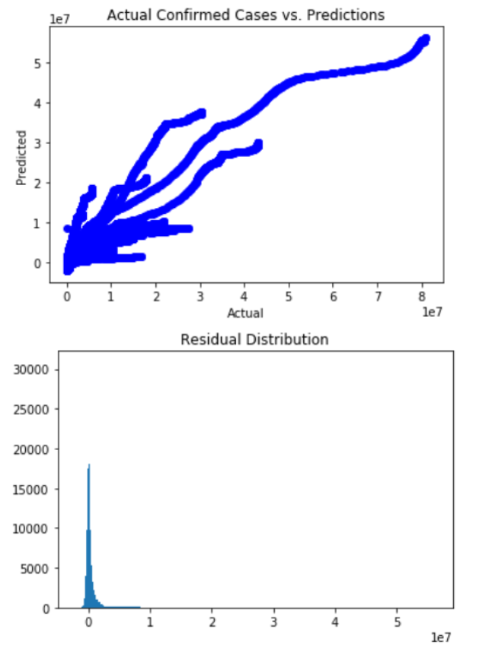
OLS Model - Evaluate Residuals
The residuals has a near-normal distribution. Therefore, there is no concerns with the residuals with this OLS Model.

Slide 15
Linear Regression Model
With sklearn libaries, I performed training and testing sets split of 80/20.
Data preprocessing process includes standardization of numerical values, transformation categorical variables into dummy variables.

Slide 16
Linear Regression Model Pipeline
The pipeline involves the linear regression model.
The R-squared for both training and testing sets are about 84%.
No indication of model overfitting.

Slide 17
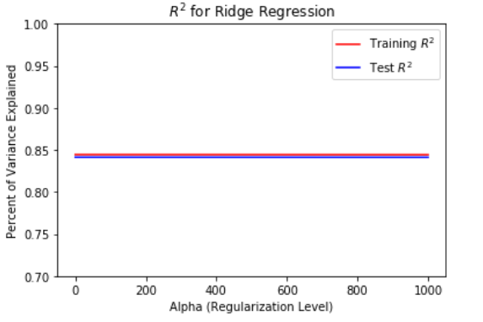
Ridge Regression for model regularization
The ridge regression term used is alphas = [0.001, 0.01, 0.1, 1, 10, 100, 1000]
𝑅-squared is still around 84% for both training and testing data sets.
Therefore, Ridge regression does not seem to change the model for the better fitting. In conclusion, OLS model was also good by itself.

Slide 18
Conclusions
Based on the findings of this study, we can return to the hypothesis questions by concluding that :
Some of the policy responses contributed in minimizing the number of coronavirus disease infection rates, especially in the early phase of the pandemic. The stringency index was higher when the countries started imposing the lockdown measures after seeing the rise in infections and daily deaths during the pandemic.

Slide 19
2. The Ordinary Least-Squares (OLS) regression model used for this project show that most the attributes or columns from this dataset are statistically significant, except H1_Flag, H7_Flag, V1_Vaccine Prioritisation (summary), V2G_Frontline workers (healthcare), V2B_Vaccine age eligibility/availability age floor (general population summary)_55-59 yrs, V2B_Vaccine age eligibility/availability age floor (general population summary)_80+ yrs, V2C_Vaccine age eligibility/availability age floor (at risk summary)_16-19 yrs, V2C_Vaccine age eligibility/availability age floor (at risk summary)_55-59 yrs, and V2C_Vaccine age eligibility/availability age floor (at risk summary)_75-79 yrs.

Slide 20
3. Among the presented COVID-19 policy responses, the drivers in predicting the ConfirmedCases are:
ConfirmedDeaths
H2_Testing policy, V4_Mandatory Vaccination (summary)
H8_Protection of elderly people.

Slide 21
References
Oxford COVID-19 Government Response Tracker, Blavatnik School of Government, University of Oxford.
https://www.bsg.ox.ac.uk/research/research-projects/covid-19-government-response-tracker
https://github.com/OxCGRT/covid-policy-tracker
Python Machine Learning, 3rd Edition, Raschka and Mirjalili.

